Slide 1
Scientific Machine Learning for Modeling, Optimization, and Control of Dynamical Systems
Ján Drgoňa
Associate Professor Civil and Systems Engineering Department The Ralph O'Connor Sustainable Energy Institute (ROSEI)
Data Science and AI Institute (DSAI)

Slide 2
Course Syllabus
Week 1: Introduction to Scientific Machine Learning (SciML)
Week 2: Preliminaries and Introduction to differentiable programming
Week 3: Physics-informed neural networks (PINNs)
Week 4: Neural ordinary differential equations (NODEs)
Week 5: Learning to optimize (L2O)
Week 6: Optimal control preliminaries
Week 7: Learning to control (L2C)
Week 8: Neural differential and difference equations with constraints
Week 9: Differentiable optimization
Week 10: Feasibility layers
Week 11: Selected topics
Week 12: Project evaluation with presentations
Week 13: Project evaluation with presentations

Slide 3
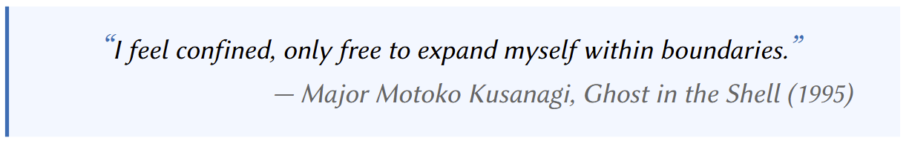

Differentiable Optimization and Feasibility Layers

Slide 4
Literature on Differentiable Optimization and Feasibility Layers
Brandon Amos, J. Zico Kolter, OptNet: Differentiable Optimization as a Layer in Neural Networks, ICML, 2017
Agrawal, A. and Amos, B. and Barratt, S. and Boyd, S. and Diamond, S. and Kolter, Z., Differentiable Convex Optimization Layers, NeurIPS 2019
James Kotary, et al., End-to-End Constrained Optimization Learning: A Survey, IJCAI, 2021
P. Donti, et al., DC3: A learning method for optimization with hard constraints, 2021
M. Li, et al., Learning to Solve Optimization Problems with Hard Linear Constraints, 2022
R. Sambharya, et al., End-to-End Learning to Warm-Start for Real-Time Quadratic Optimization, 2022
James Kotary, My H. Dinh, Ferdinando Fioretto, Backpropagation of Unrolled Solvers with Folded Optimization, IJCAI, 2023
Quill Healey, Parth Nobel, Stephen Boyd, Differentiating Through a Quadratic Cone Program, 2025
Maximilian Schaller, Stephen Boyd, Code generation for solving and differentiating through convex optimization problems, 2025
Rajiv Sambharya, Jinho Bok, Nikolai Matni, George Pappas, Learning Acceleration Algorithms for Fast Parametric Convex Optimization with Certified Robustness, 2025
Pascal Van Hentenryck, Optimization learning, arXiv:2501.03443, 2025
https://implicit-layers-tutorial.org/differentiable_optimization/

Slide 5
Literature on Predict then Optimize or Decision-Focused Learning
Bo Tang, and Elias Khalil, PyEPO: a PyTorch-based end-to-end predict-then-optimize library for linear and integer programming, Mathematical Programming Computation. 2024
James Kotary, Vincenzo Di Vito, Jacob Christopher, Pascal Van Hentenryck, Ferdinando Fioretto, Predict-Then-Optimize by Proxy: Learning Joint Models of Prediction and Optimization, arXiv:2311.13087, 2023
R. Sambharya, et al., End-to-End Learning to Warm-Start for Real-Time Quadratic Optimization, 2022
Rajiv Sambharya, Georgina Hall, Brandon Amos, Bartolomeo Stellato; Learning to Warm-Start Fixed-Point Optimization Algorithms, JMLR, 2024
E. King, J. Kotary, F. Fioretto and J. Drgoňa, "Metric Learning to Accelerate Convergence of Operator Splitting Methods," CDC, 2024
Elmachtoub, A. N., & Grigas, P. (2021). Smart “predict, then optimize”. Management Science.
Mandi, J., Stuckey, P. J., & Guns, T. (2020). Smart predict-and-optimize for hard combinatorial optimization problems. In Proceedings of the AAAI Conference on Artificial Intelligence.
Vlastelica, M., Paulus, A., Musil, V., Martius, G., & Rolínek, M. (2019). Differentiation of blackbox combinatorial solvers. arXiv:1912.02175.
Berthet, Q., Blondel, M., Teboul, O., Cuturi, M., Vert, J. P., & Bach, F. (2020). Learning with differentiable pertubed optimizers. Advances in neural information processing systems, 33, 9508-9519.
Mulamba, M., Mandi, J., Diligenti, M., Lombardi, M., Bucarey, V., & Guns, T. (2021). Contrastive losses and solution caching for predict-and-optimize. Proceedings of the Thirtieth International Joint Conference on Artificial Intelligence.
Mandi, J., Bucarey, V., Mulamba, M., & Guns, T. (2022). Decision-focused learning: through the lens of learning to rank. Proceedings of the 39th International Conference on Machine Learning
Sahoo, S. S., Paulus, A., Vlastelica, M., Musil, V., Kuleshov, V., & Martius, G. (2022). Backpropagation through combinatorial algorithms: Identity with projection works. arXiv preprint arXiv:2205.15213.
Niepert, M., Minervini, P., & Franceschi, L. (2021). Implicit MLE: backpropagating through discrete exponential family distributions. Advances in Neural Information Processing Systems, 34, 14567-14579.
Minervini, P., Franceschi, L., & Niepert, M. (2023, June). Adaptive perturbation-based gradient estimation for discrete latent variable models. In Proceedings of the AAAI Conference on Artificial Intelligence (Vol. 37, No. 8, pp. 9200-9208).
Schutte, N., Postek, K., & Yorke-Smith, N. (2023). Robust Losses for Decision-Focused Learning. arXiv preprint arXiv:2310.04328.
Gupta, V., & Huang, M. (2024). Decision-Focused Learning with Directional Gradients. Training, 50(100), 150.
Toon Vanderschueren, Tim Verdonck, Bart Baesens, Wouter Verbeke, Predict-then-optimize or predict-and-optimize? An empirical evaluation of cost-sensitive learning strategies, Information Sciences, Volume 594, 2022

Slide 6
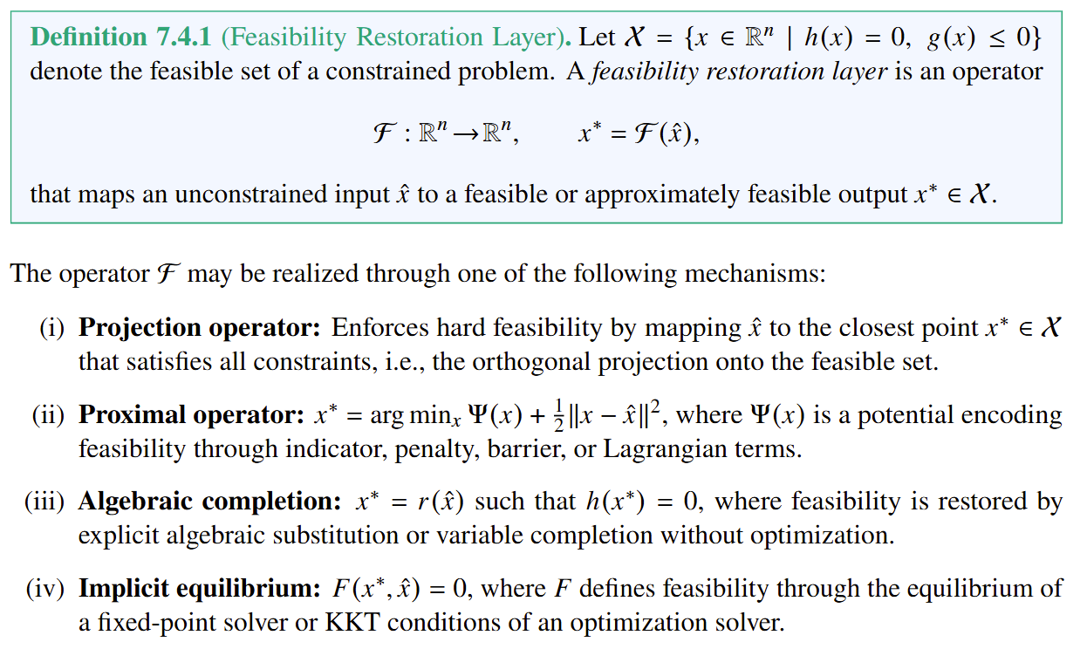
Feasibility Restoration (Repair) Layers

Slide 7
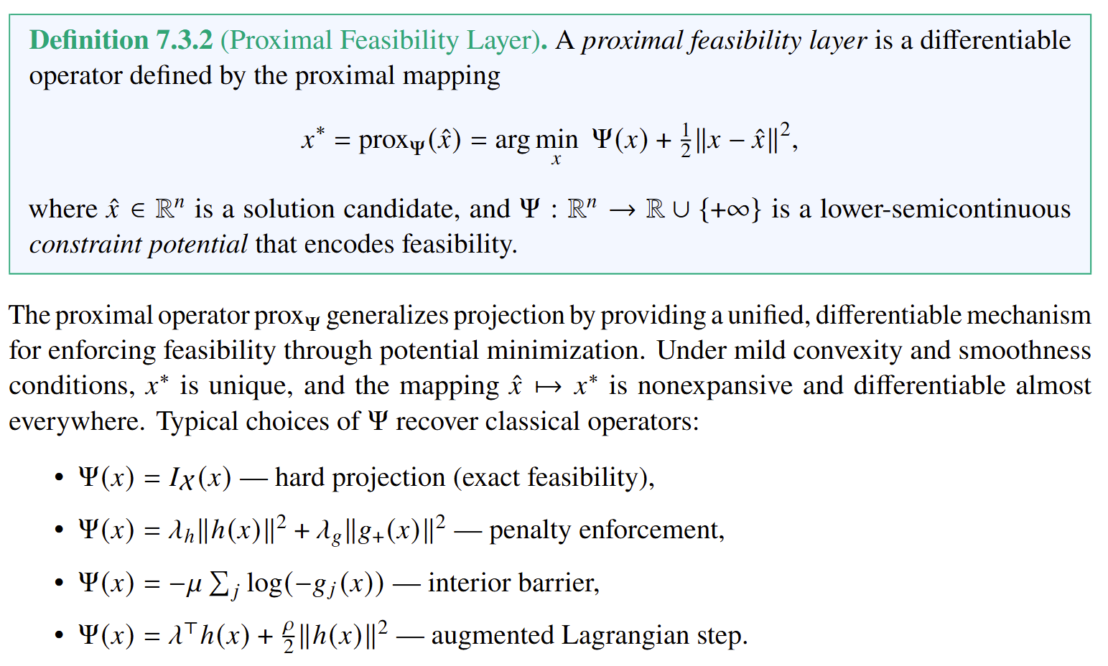
Proximal Operator Feasibility Layers
https://en.wikipedia.org/wiki/Proximal_operator

Slide 8
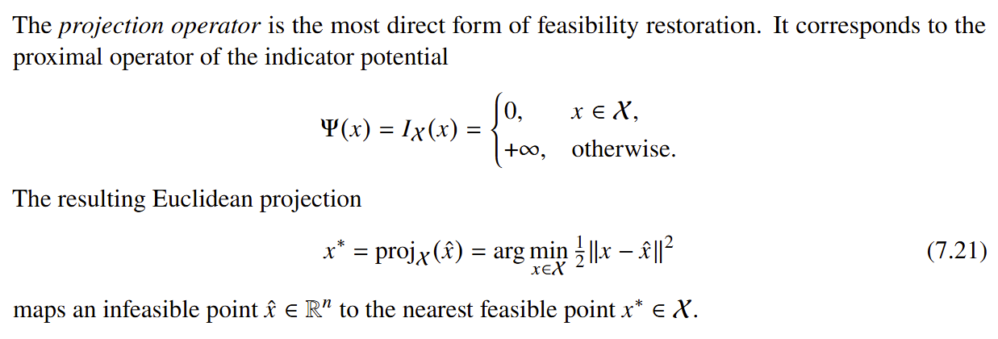
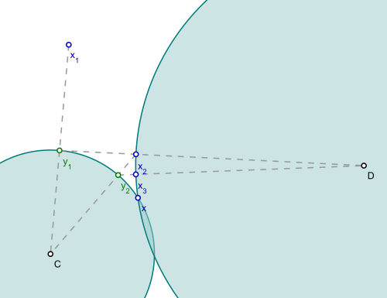
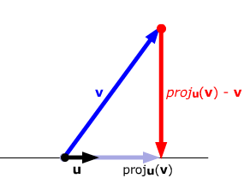
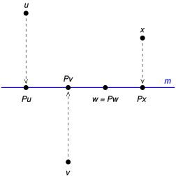
Projection Feasibility Layers
https://en.wikipedia.org/wiki/Projection_(linear_algebra)
https://en.wikipedia.org/wiki/Projections_onto_convex_sets

Slide 9
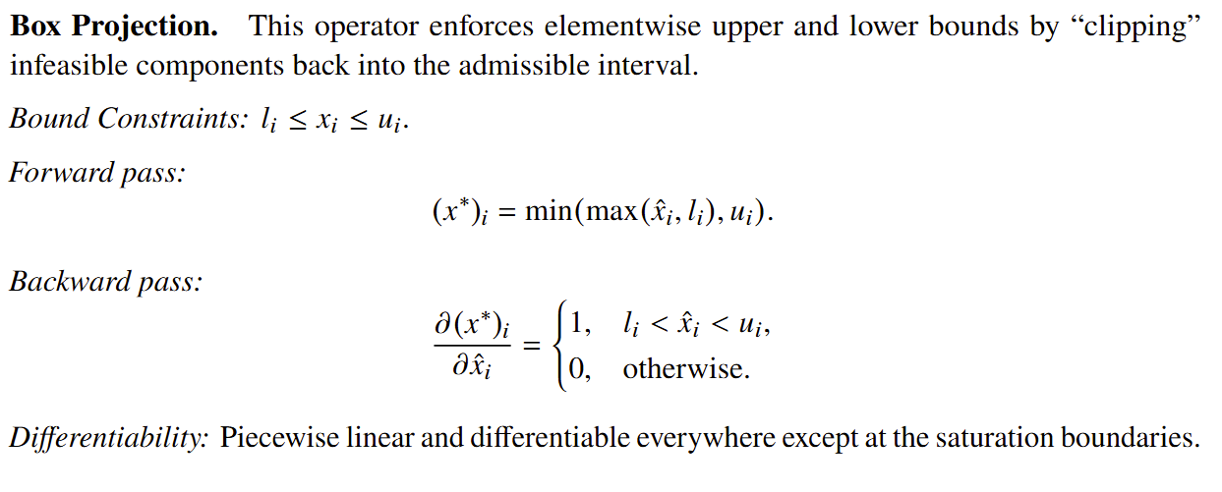
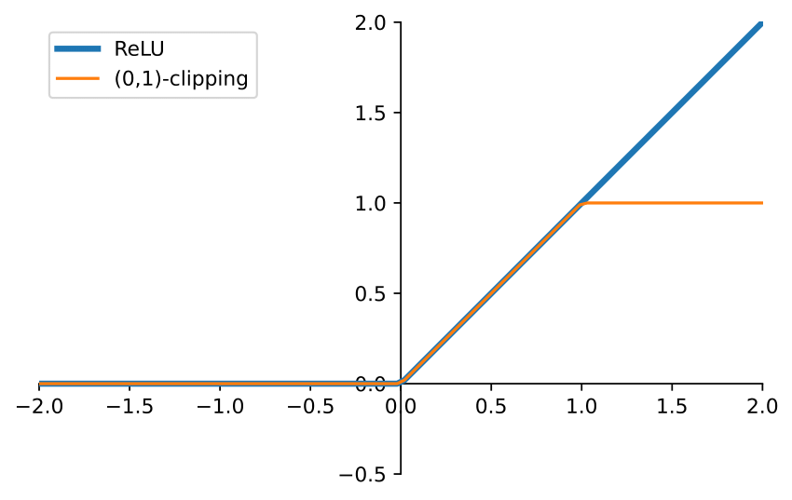
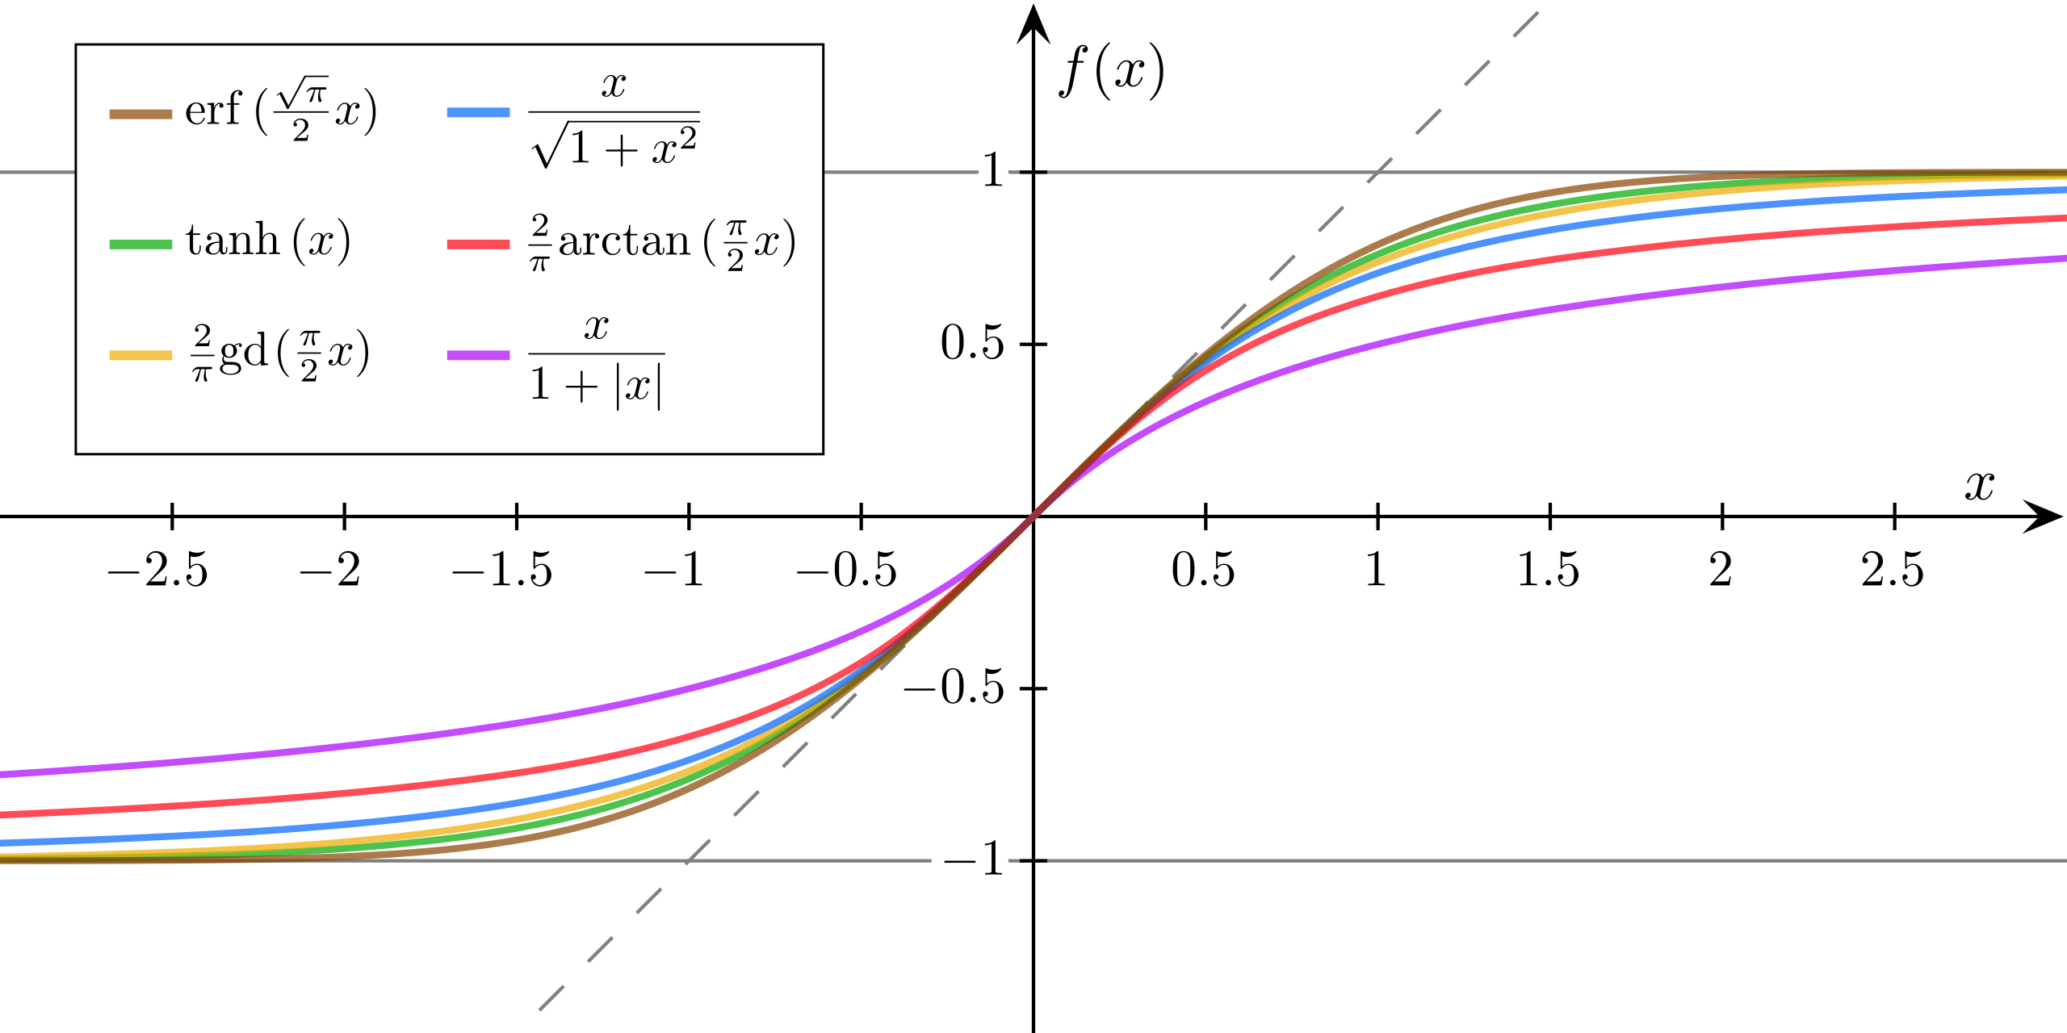
Closed-Form Projections

Slide 10
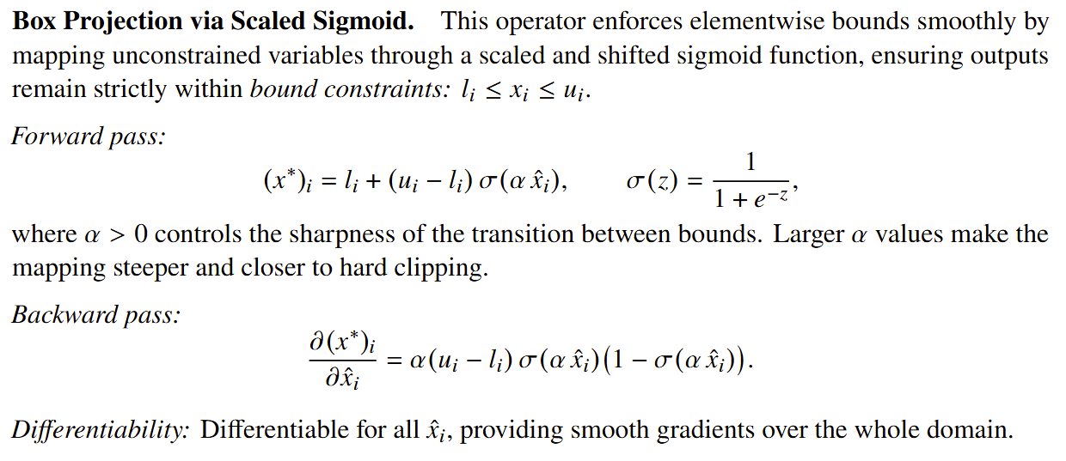
Closed-Form Projections

Slide 11
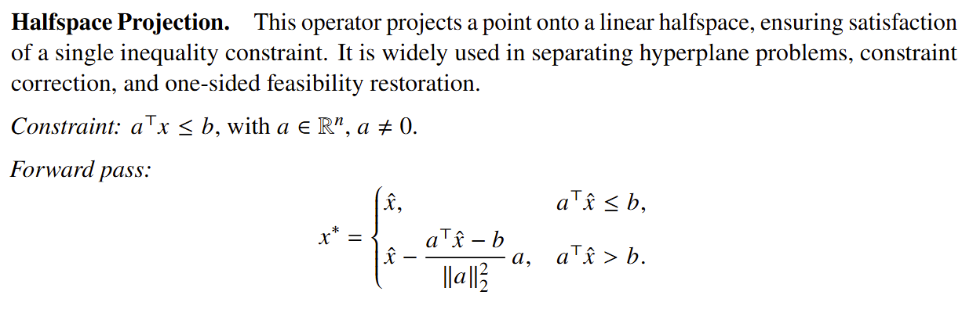
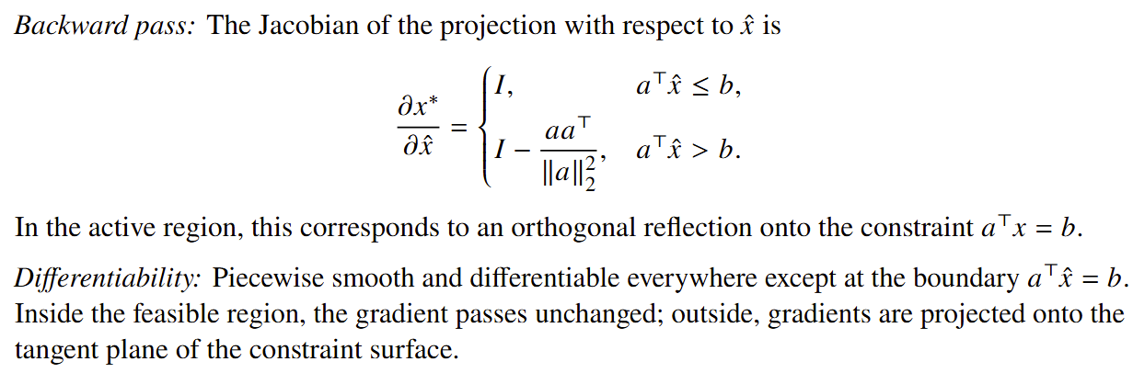
Closed-Form Projections

Slide 12
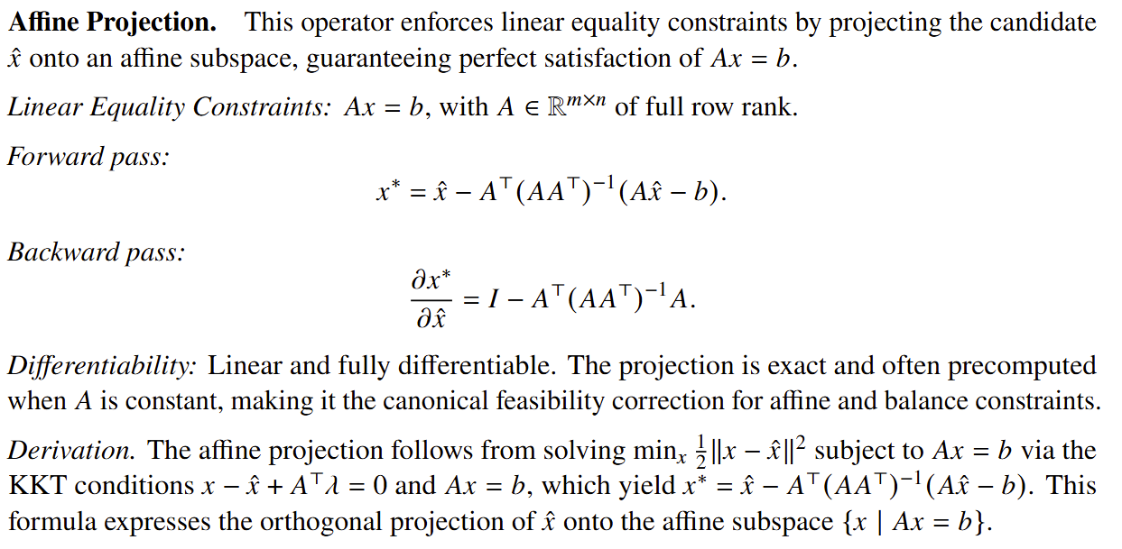
Closed-Form Projections

Slide 13
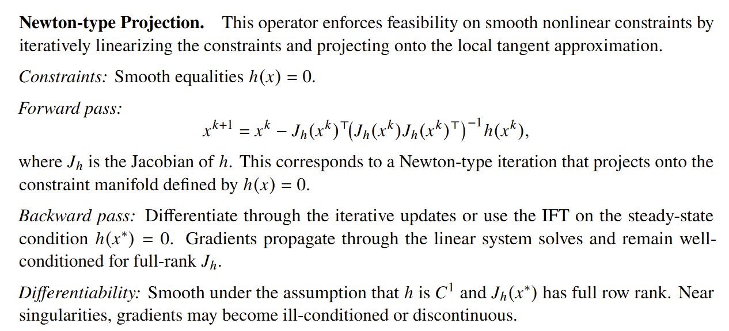
Iterative Projections

Slide 14
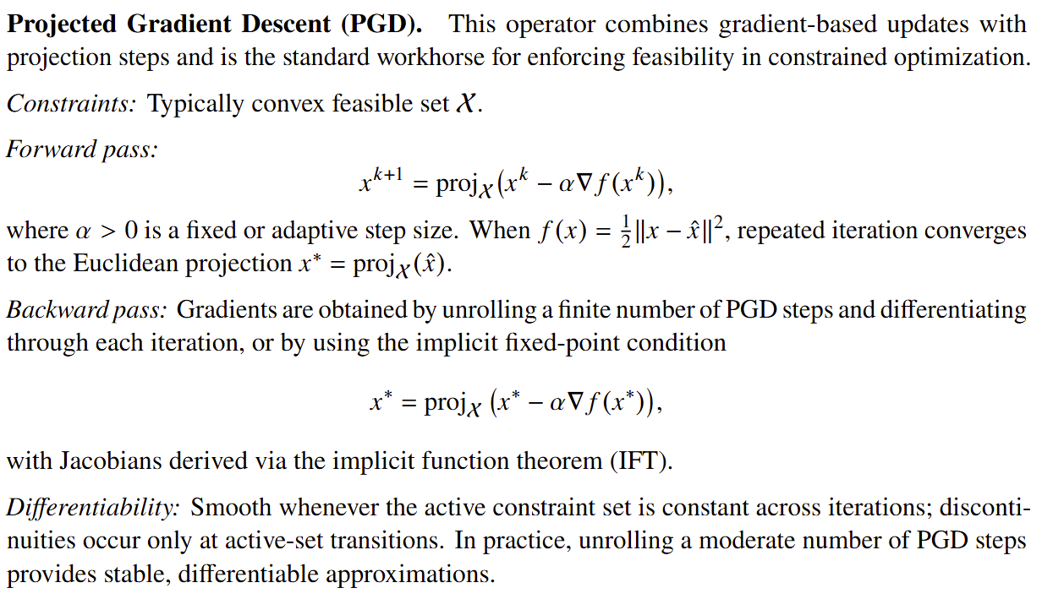
Iterative Projections

Slide 15
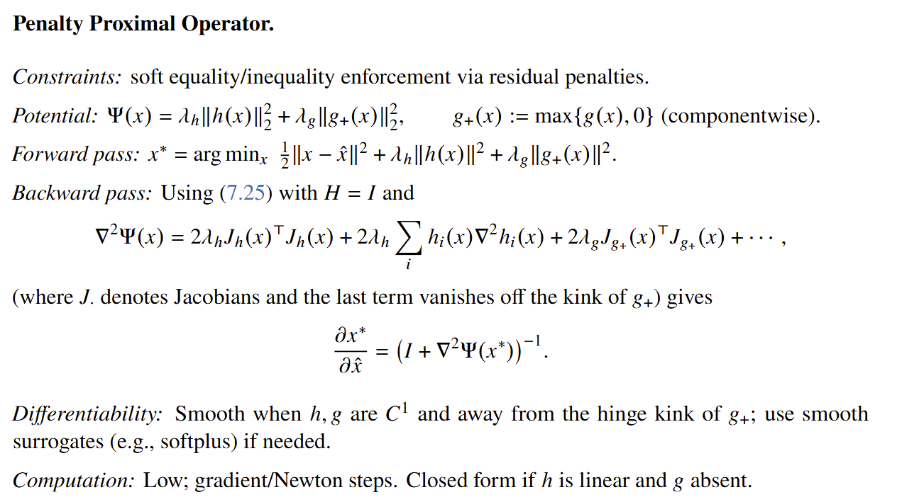
Proximal Operators

Slide 16
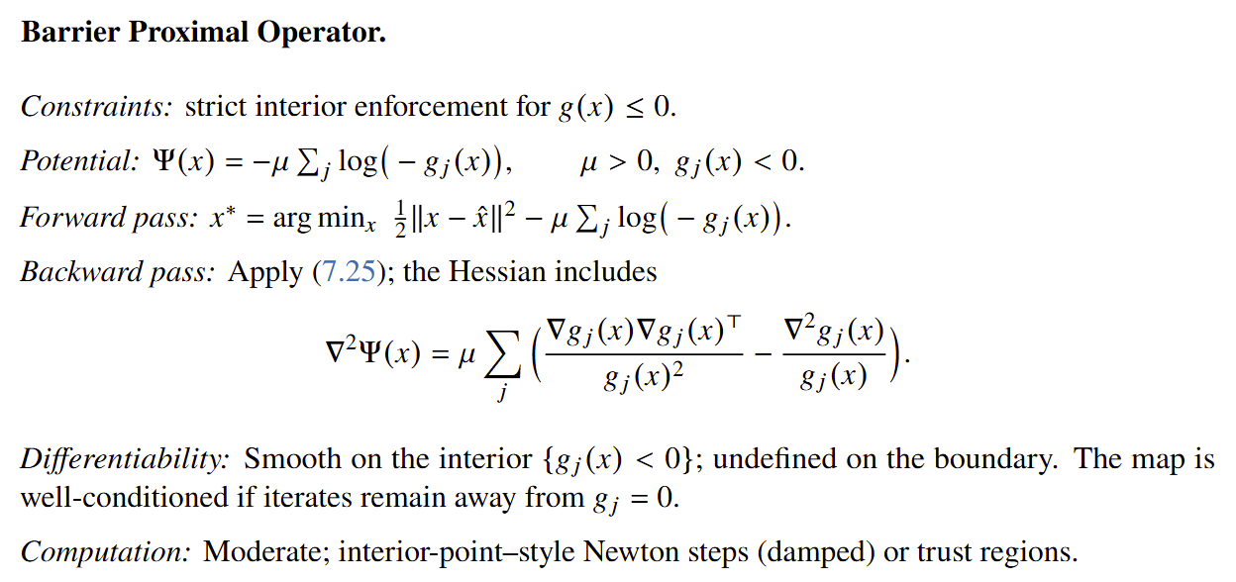
Proximal Operators

Slide 17
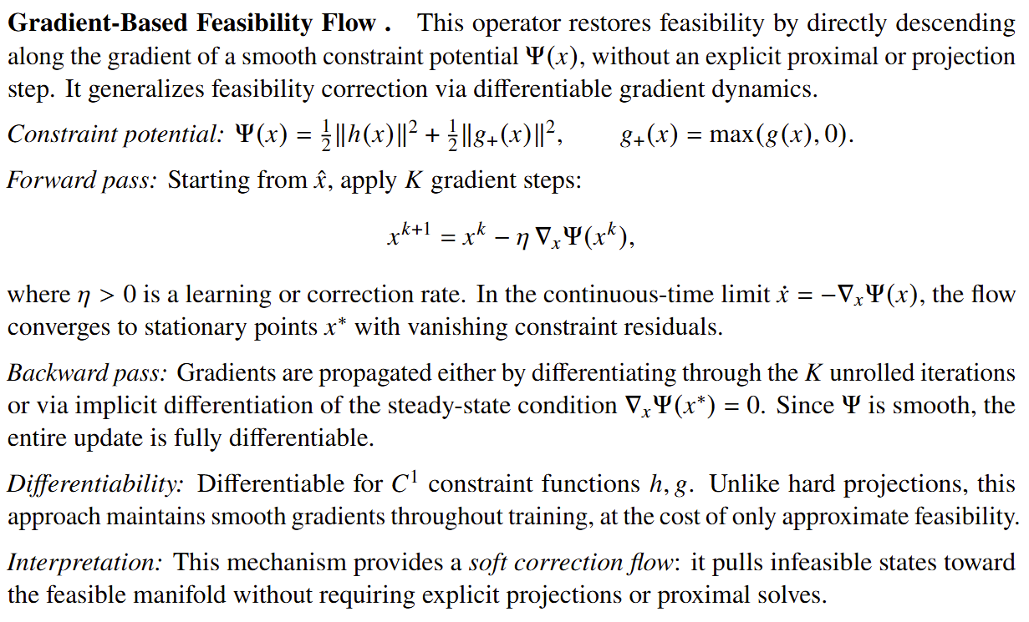
Gradient-based Feasibility Flow

Slide 18
Algebraic Completion Layers
Unrolling of dynamic constraints
Variable completion for lin constrs

Slide 19
Implicit Equilibrium Layers
Unrolling of dynamic constraints
Variable completion for lin constrs

Slide 20
Cvxpy Layers

Slide 21
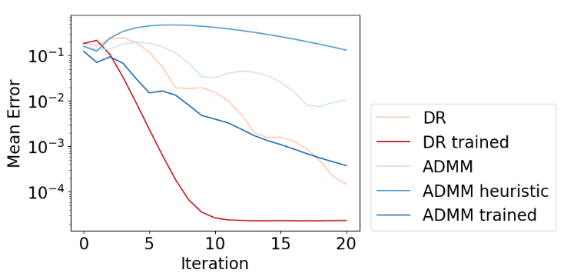
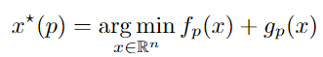
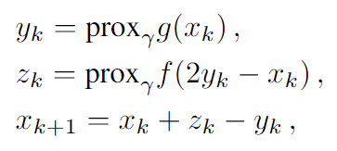
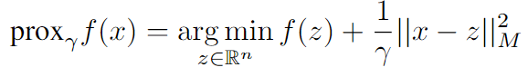
Metric Learning to Accelerate Convergence of Operator Splitting Methods
Parametric programming setting:
Douglas-Rachford splitting (DR) algorithm:
Metric learning can accelerate convergence of DR and ADMM algorithms via end-to-end metric learning.
Idea: Train neural network to optimize the metric as a function of problem parameters:
Ethan King, James Kotary, Ferdinando Fioretto, Jan Drgona, Metric Learning to Accelerate Convergence of Operator Splitting Methods for Differentiable Parametric Programming, Under review for CDC 2024.

Slide 22
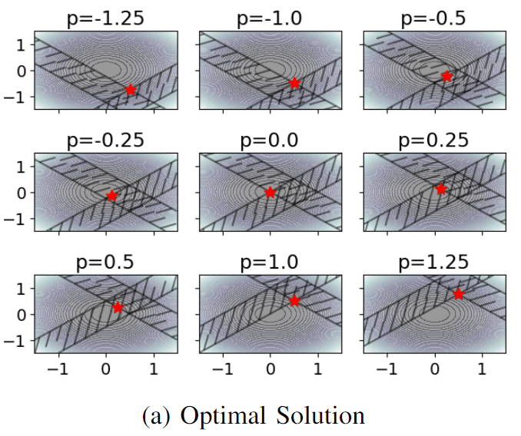
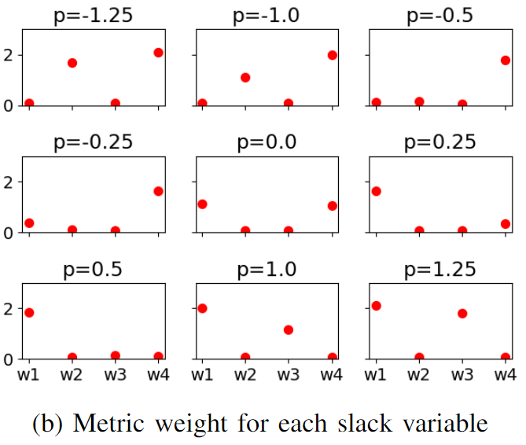
Metric Learning is a Form of Active Set Prediction
https://colab.research.google.com/github/pnnl/neuromancer/blob/master/examples/parametric_programming/Part_6_pQp_lopoCorrection.ipynb
Ethan King, James Kotary, Ferdinando Fioretto, Jan Drgona, Metric Learning to Accelerate Convergence of Operator Splitting Methods for Differentiable Parametric Programming, Under review for CDC 2024.

Slide 23
Challenges of Learning to Optimize For Mixed-Integer Problems
1. Collecting Solutions as Training Labels for Supervised Learning is Very Expensive
Our Solution: Self-Supervised Learning Approach without requiring solutions for training.
2. Neural Networks Cannot Directly Output Integer Values
Our Solution: Differentiable Integer Correction Layers to ensure integer feasibility.
3. It is Difficult to Ensure Feasibility, Especially in Integers
Our Solution: Gradient-based Feasibility Projection to guarantee feasible integer solutions.
Selected Existing L2O methods Ferdinando Fioretto, et al., Predicting ac optimal power flows: Combining deep learning and lagrangian dual methods. AAAI conference on AI, 2020.
Priya Donti, et al., DC3: A learning method for optimization with hard constraints, ICLR, 2021
James Kotary, et al., End-to-end constrained optimization learning: A survey. arXiv preprint arXiv:2103.16378, 2021.
He He, et al., Learning to search in branch and bound algorithms. NeurIPS, 2014.
Elias Khalil, et al., Learning to branch in mixed integer programming. AAAI Conference on AI, 2016.
Maxime Gasse, et al., Exact combinatorial optimization with graph convolutional neural networks. NeruIPS, 2019.
Timo Berthold , et al., Learning to scale mixed-integer programs. AAAI Conference on AI, 2021.
Yoshua Bengio, et al., Machine learning for combinatorial optimization: a methodological tour d’horizon. European Journal of Operational Research, 2021.
Dimitris Bertsimas and Bartolomeo Stellato. Online mixed-integer optimization in milliseconds. INFORMS Journal on Computing, 2022.

Slide 24
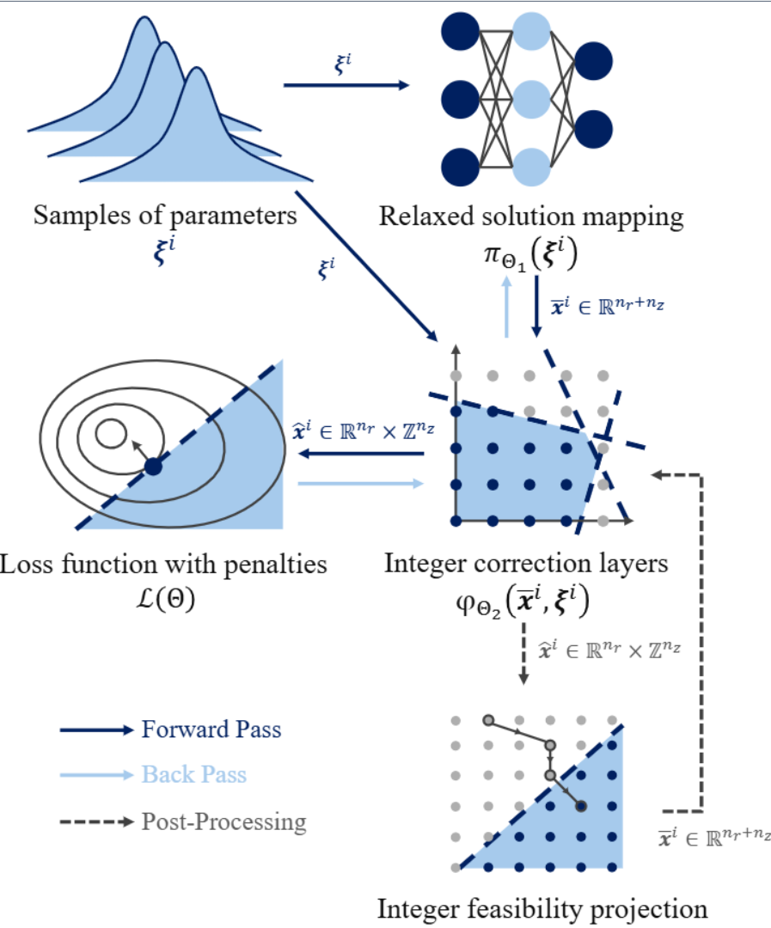
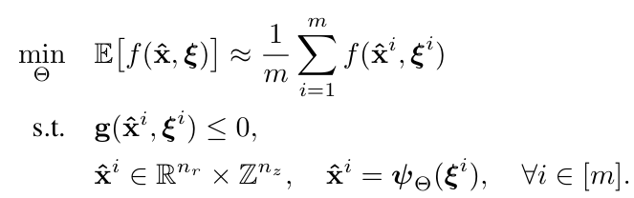
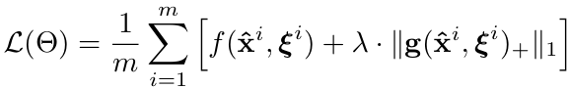
Learning to Optimize for Mixed-Integer Nonlinear Programming
Learning problem formulation:
Penalty loss function reformulation:
Amortized optimization allows scaling to some of the largest MINLPs.
Could also be used as primal heuristics.
Bo Tang, Elias B. Khalil, Ján Drgoňa, Learning to Optimize for Mixed-Integer Non-linear Programming, arXiv:2410.11061, 2024

Slide 25
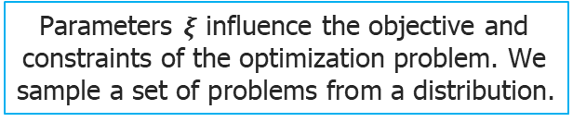
Learning to Optimize for Mixed-Integer Nonlinear Programming
Learning problem formulation:
Penalty loss function reformulation:
Parameters $ξ$ influence the objective and constraints of the optimization problem. We sample a set of problems from a distribution.
Bo Tang, Elias B. Khalil, Ján Drgoňa, Learning to Optimize for Mixed-Integer Non-linear Programming, arXiv:2410.11061, 2024

Slide 26
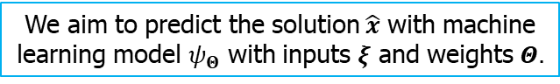
Learning to Optimize for Mixed-Integer Nonlinear Programming
Learning problem formulation:
Penalty loss function reformulation:
We aim to predict the solution $\hat{x}$ with machine learning model $ψ_{Θ}$ with inputs $ξ$ and weights $Θ.$
Bo Tang, Elias B. Khalil, Ján Drgoňa, Learning to Optimize for Mixed-Integer Non-linear Programming, arXiv:2410.11061, 2024

Slide 27
Learning to Optimize for Mixed-Integer Nonlinear Programming
Learning problem formulation:
Penalty loss function reformulation:
Until now this is standard self-supervised L2O for continuous problems.
Bo Tang, Elias B. Khalil, Ján Drgoňa, Learning to Optimize for Mixed-Integer Non-linear Programming, arXiv:2410.11061, 2024

Slide 28
Learning to Optimize for Mixed-Integer Nonlinear Programming
Learning problem formulation:
Penalty loss function reformulation:
Main innovation of the paper: Integer correction layers and integer feasibility projection
Bo Tang, Elias B. Khalil, Ján Drgoňa, Learning to Optimize for Mixed-Integer Non-linear Programming, arXiv:2410.11061, 2024

Slide 29
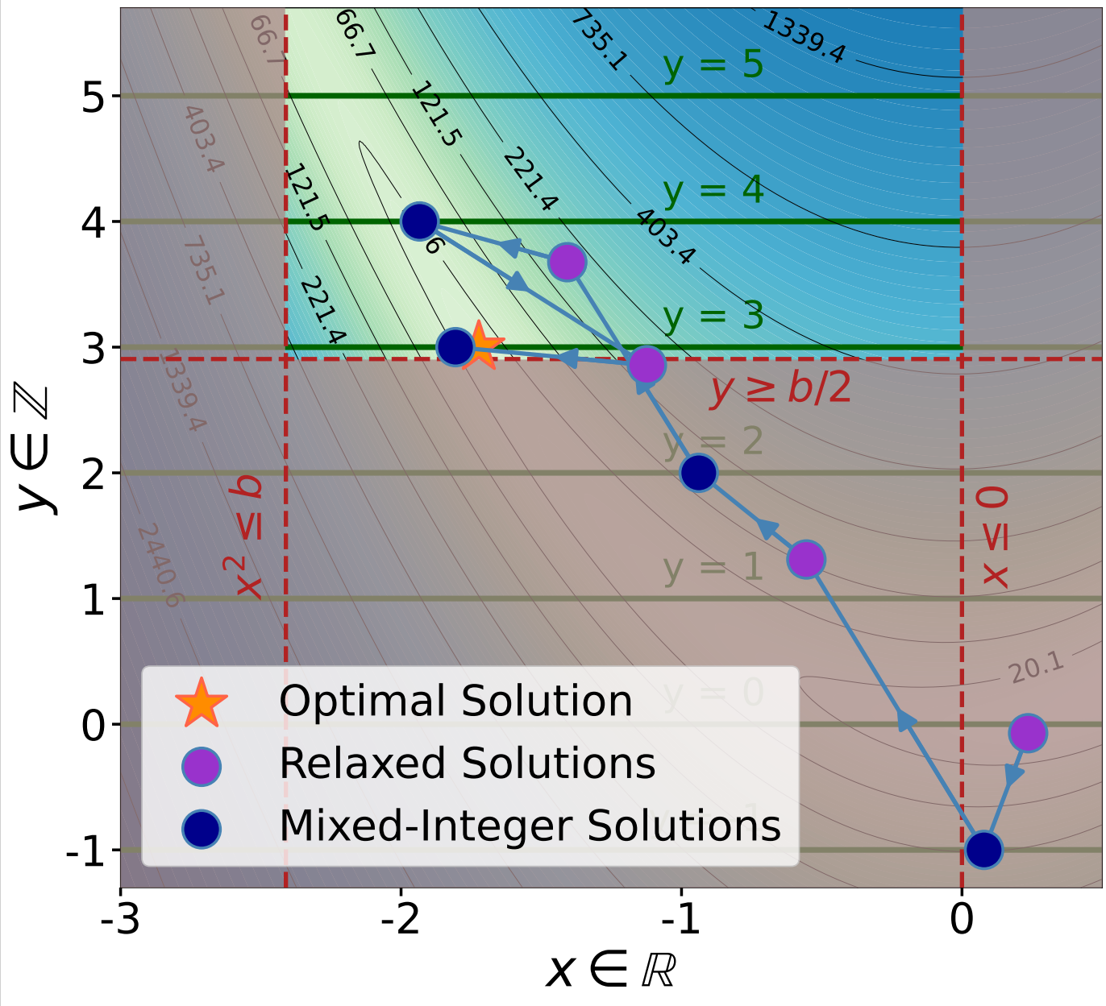
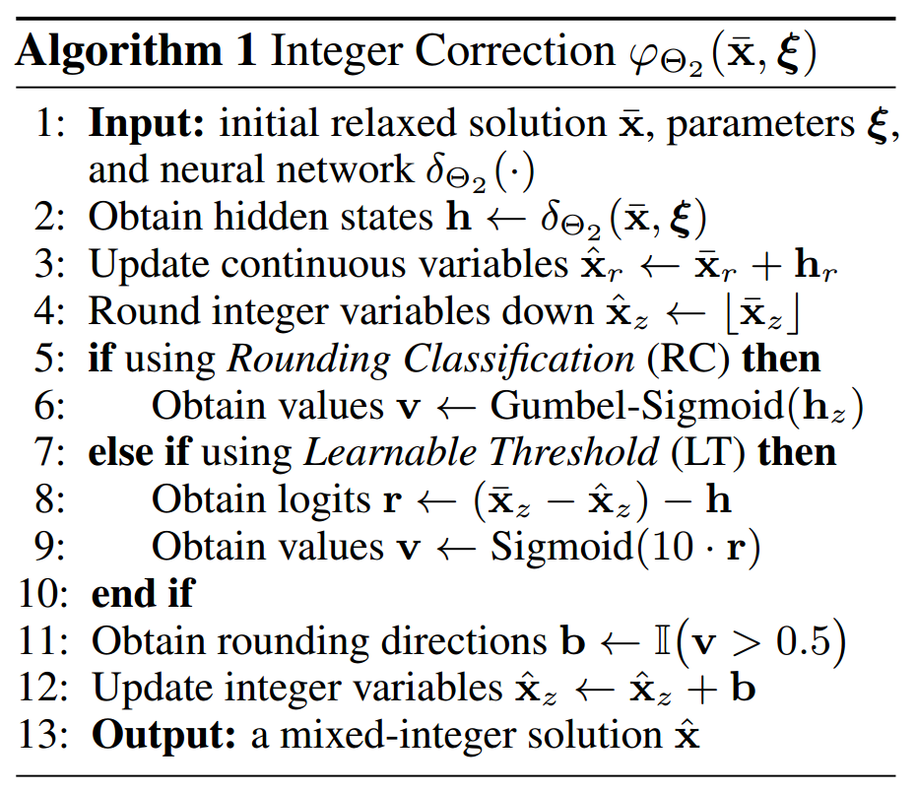
Differentiable Integer Correction Layers
Learnable end-to-end extension of the Relaxation Enforced Neighborhood Search (RENS).
Bo Tang, Elias B. Khalil, Ján Drgoňa, Learning to Optimize for Mixed-Integer Non-linear Programming, arXiv:2410.11061, 2024

Slide 30
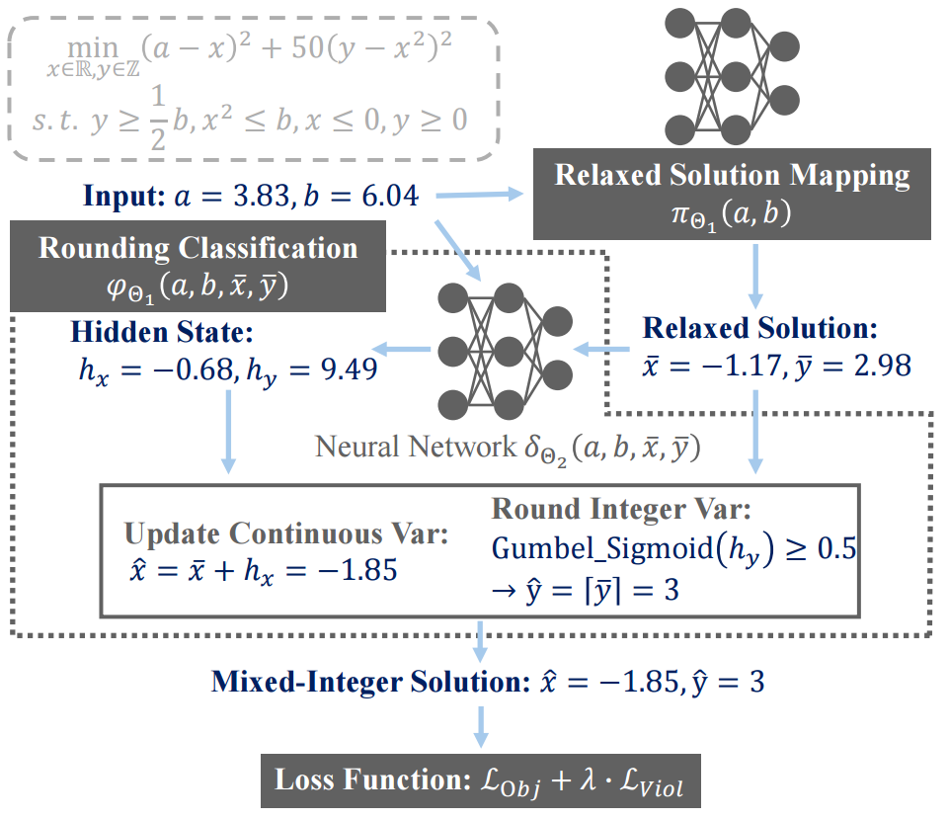
Differentiable Integer Correction Layers: RC Example
Bo Tang, Elias B. Khalil, Ján Drgoňa, Learning to Optimize for Mixed-Integer Non-linear Programming, arXiv:2410.11061, 2024

Slide 31
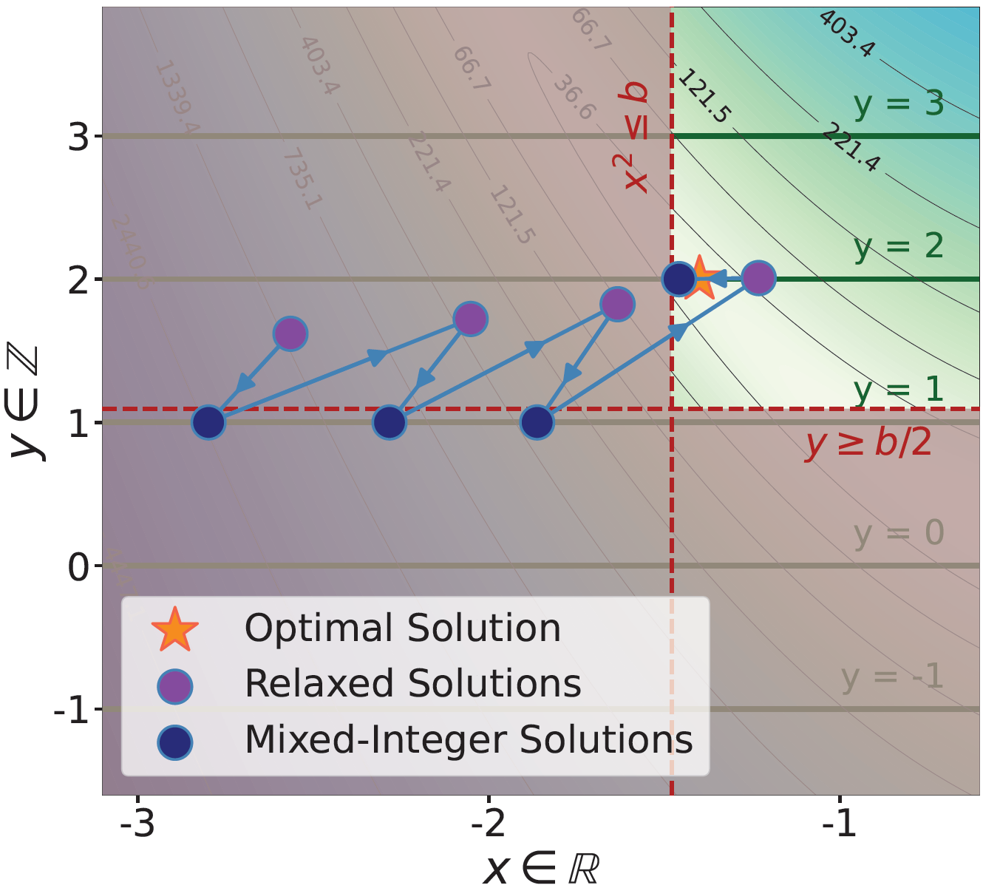
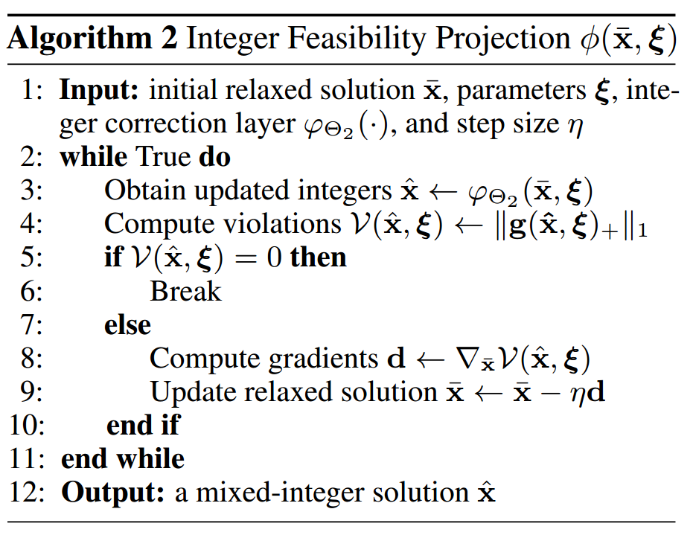
Integer Feasibility Projection
Learning-based alternative to Feasibility Pump which also alternates between rounding and projection.
Bo Tang, Elias B. Khalil, Ján Drgoňa, Learning to Optimize for Mixed-Integer Non-linear Programming, arXiv:2410.11061, 2024

Slide 32
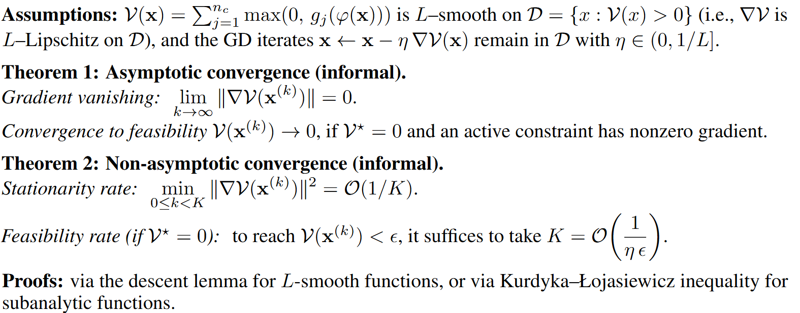
Approximate Feasibility Guarantees for Integer Projection
Bo Tang, Elias B. Khalil, Ján Drgoňa, Learning to Optimize for Mixed-Integer Non-linear Programming, arXiv:2410.11061, 2024

Slide 33
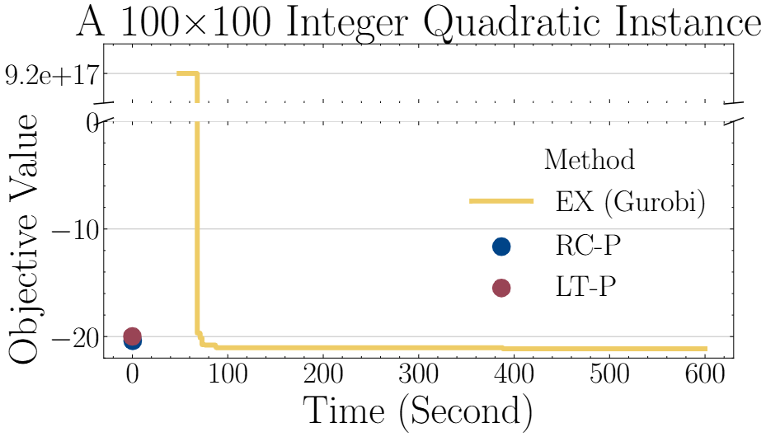
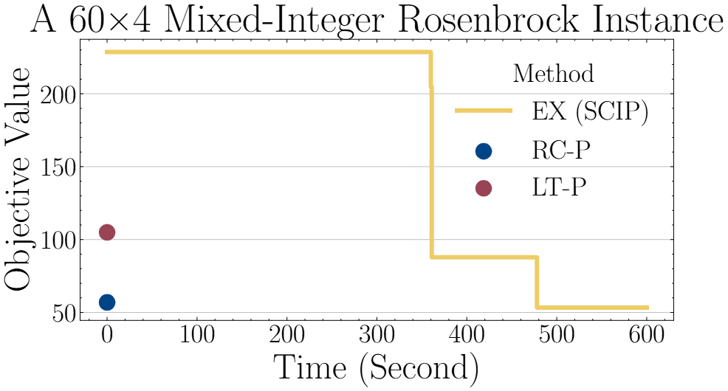
L2O for MINLP: Comparison with Exact Solvers (Gurobi & SCIP)
Exact solvers such as Gurobi and SCIP can find better solutions over time but are slow. In contrast, our methods achieve high-quality feasible solutions within milliseconds. Our methods provide up to 5 orders of magnitude speedup.
https://github.com/pnnl/L2O-pMINLP
Bo Tang, Elias B. Khalil, Ján Drgoňa, Learning to Optimize for Mixed-Integer Non-linear Programming, arXiv:2410.11061, 2024

Slide 34
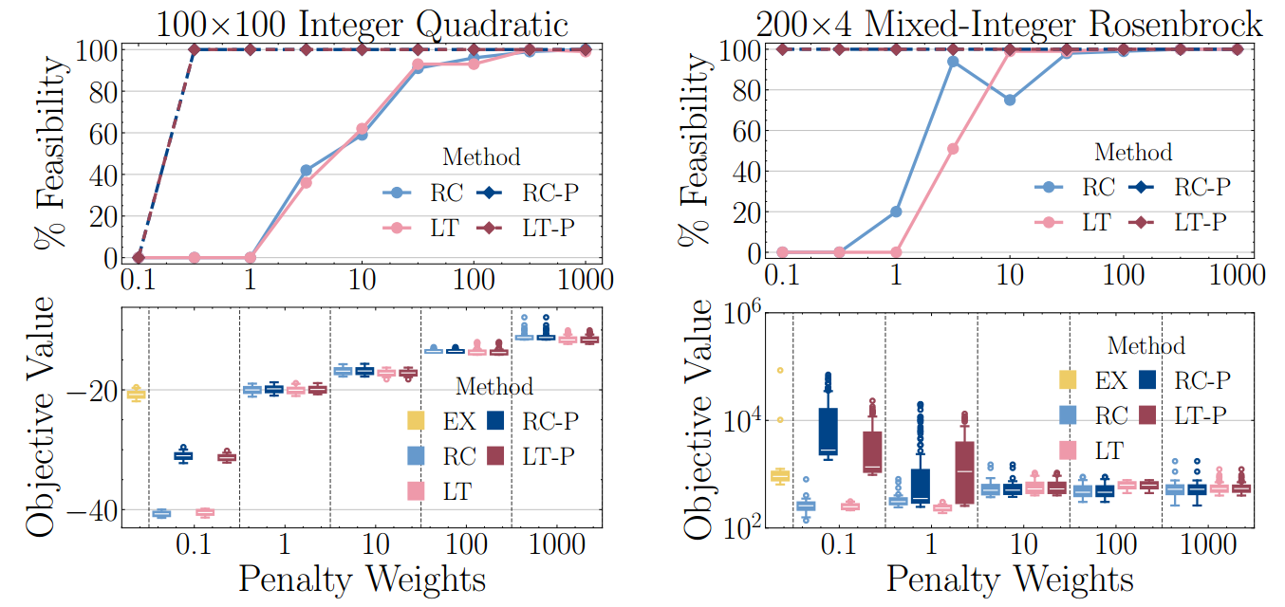
Effect of Penalty Weights and Integer Projections on Feasibility
Integer feasibility projection (RC-P and LT-P), improves feasibility even with smaller penalty weights. Without projection there is a trade-off between feasibility and objective values (RC and LT).
https://github.com/pnnl/L2O-pMINLP
Bo Tang, Elias B. Khalil, Ján Drgoňa, Learning to Optimize for Mixed-Integer Non-linear Programming, arXiv:2410.11061, 2024

Slide 35
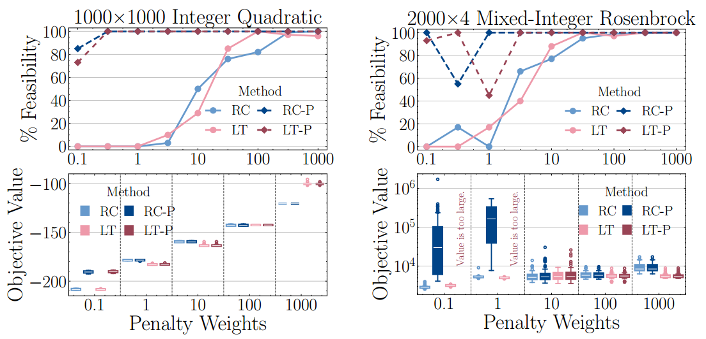
Effect of Penalty Weights and Integer Projections on Feasibility
Integer feasibility projection (RC-P and LT-P), improves feasibility even with smaller penalty weights. Without projection there is a trade-off between feasibility and objective values (RC and LT).
https://github.com/pnnl/L2O-pMINLP
Bo Tang, Elias B. Khalil, Ján Drgoňa, Learning to Optimize for Mixed-Integer Non-linear Programming, arXiv:2410.11061, 2024

Slide 36

L2O in NeuroMANCER Scientific Machine Learning Library
L2O Examples
L2O for a constrained optimization problem.
L2O for a quadratically-constrained optimization problem.
L2O for a set of 2D constrained optimization problems.
L2O for a constrained optimization problem with the projected gradient.
L2O with Cvxpylayers for differentiable projection onto the feasible set.
L2O with metric learning using Operator Splitting layers.
github.com/pnnl/neuromancer

Slide 37
Homework Assignment: Project Proposal
Project proposal: Write a 2-page long proposal 11pt font for your semester project written either using word or pdf generated using Latex.
The proposal must include following paragraphs:
Summary: Single sentence providing concise overview of the proposal.
Introduction: Provides context and problem statement. Answers what is the problem and why is the problem important.
Objectives: States clear and specific objectives of the proposal. Answers what we want to achieve.
Technical approach: Detailed explanation of how the project will be executed. Provides steps, strategies, and techniques to be used. Answers how are we going to achieve our objectives.
Expected outcomes: Key results expected from the project. Performance indicators and success metrics.

Slide 38
Week 11: Project Presentations and Evaluation
Projects cover 70% of the course grade!
Project proposal 20% - week 5
Project progress report 10% - week 8
Project final report 20% - week 10
Project presentation 20% - week 11
Project format.
Project technical report: 4 to 6 page long pdf document including references and figures.
Project presentation: ppt or pdf slides, 15 min time slot per student in week 11.
Admissible topics.
Application of selected SciML methods to problems inspired by real-world applications
e.g., L2O for large scale optimization of energy systems.
Development of new methods tackling some of the open challenges in SciML
e.g., novel way of utilizing PINNs in differentiable control for PDEs.
New theory supporting selected SciML methodology
e.g., convergence analysis of feasibility restoration layers in L2O.

